Slide 1
Shanto Mariam University of Creative and Technology
Presentation on
Ensemble learning to predict air quality: A Comparative Analysis
Presented By,
Zakia Sultana Bhuiyan
ID: 213071015
Batch : 28th
Semester : Final
Department : CSE
Supervised By,
Shakkhor Das
Lecturer of CSE dept in
SMUCT

Slide 2

Outlines
Outlines
Introductions
Project Overview
Dataset & Preprocessing
Models Used
Proposed Methodology
Result and summary
Literature Review
Visual Results
Conclusion
Reference

Slide 3
Introduction
01
Introduction
This research focuses on predicting Air Quality Index (AQI) using Machine Learning and Deep Learning models.
Goal: To enhance AQI forecasting accuracy using ensemble and time-series models.

Slide 4
Project Overview
02
Overview
• Project Title: Air Quality Index Prediction using Machine Learning Models
• Objective: Predict AQI classes and values based on pollutant concentrations.
• Methods: Applied ML, DL, and time-series models (LightGBM, XGBoost, LSTM, ARIMA).
• Dataset: Real AQI monitoring data (PM2.5, PM10, SO2, CO, NO2, O3).
• Output: Classification (AQI Category) & Regression (AQI Value).
• Tools Used: Python, Scikit-learn, TensorFlow, CatBoost, LightGBM, pmdarima.

Slide 5
Dataset & Preprocessing
03
Dataset & Preprocessing
Dataset includes PM2.5, PM10, SO2, CO, NO2, and O3 pollutant levels.
Preprocessing:
• Date parsing and missing value handling
• Lag & rolling feature engineering
• Min-Max normalization
• Label encoding for AQI class

Slide 6
Models Used
04
Models Used
Classification:
Logistic Regression, Decision Tree, Random Forest, LightGBM, XGBoost, CatBoost, SVM
Regression:
Linear Regression, Random Forest, LightGBM, XGBoost, CatBoost, LSTM, ARIMA
Ensemble:
Weighted Regression Model, Stacking Ensemble

Slide 7
Proposed Methodology
05
Methodology
Modeling
Classification
Evaluation
LightGBM
Logistic Regression
Random Forest
Decision Tree
SVM
Weighted Classifier
XGBoost (tuned)
CatBoost (tuned)
Stacking Ensemble
Confusion Matrix
Predicted vs Actual plot
Data Preprocessing
Feature engineering
Regression
LTSM
Linear Regression (Logistic Regression as Regressor)
Random Forest
LightGBM
ARIMA
BP Neural Network
Weighted Classifier
XGBoost (tuned)
CatBoost (tuned)
Stacking Ensemble

Slide 8
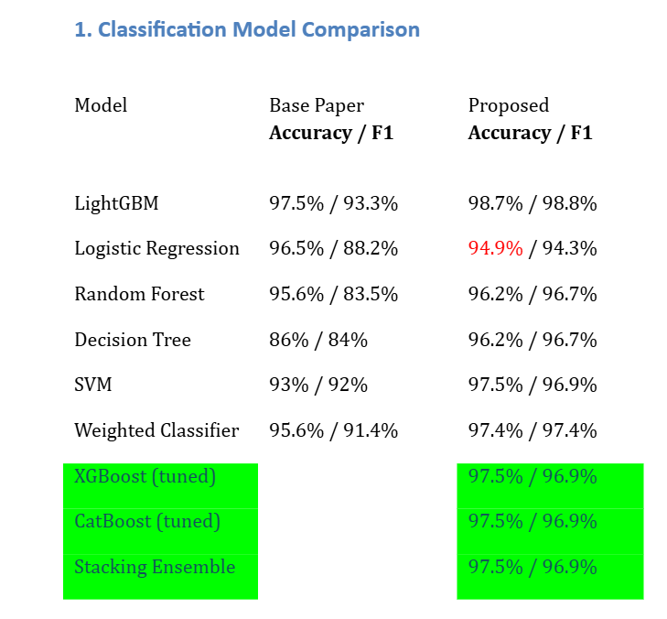
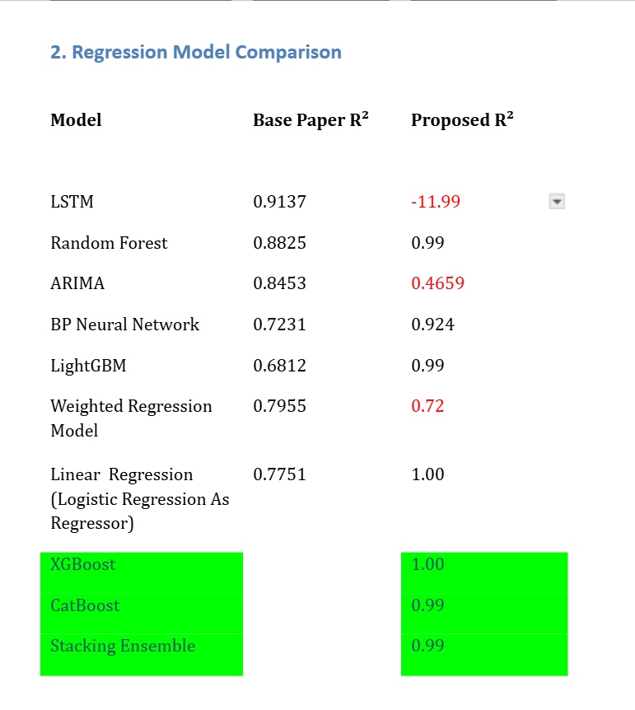
Results Summary
06
Comparison
Models Comparison:

Slide 9
Literature Review
07
Literature Review
• Liu et al. (2024): LightGBM achieved 97.5% accuracy.
• Azid et al. (2014): PCA + ANN improved AQI prediction.
• Mishra et al. (2019): ANN outperformed regression models.
• Zhu et al. (2021): ARIMA + BPNN improved PM2.5 forecasting.
• Du et al. (2022): CNN–BiLSTM enhanced long-term prediction.

Slide 10
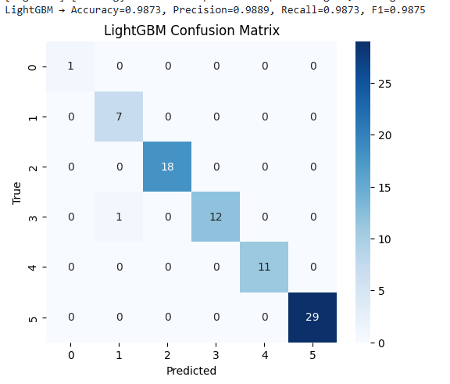
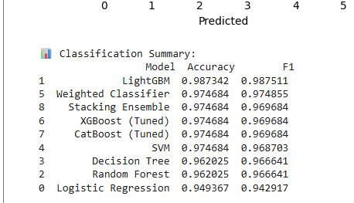
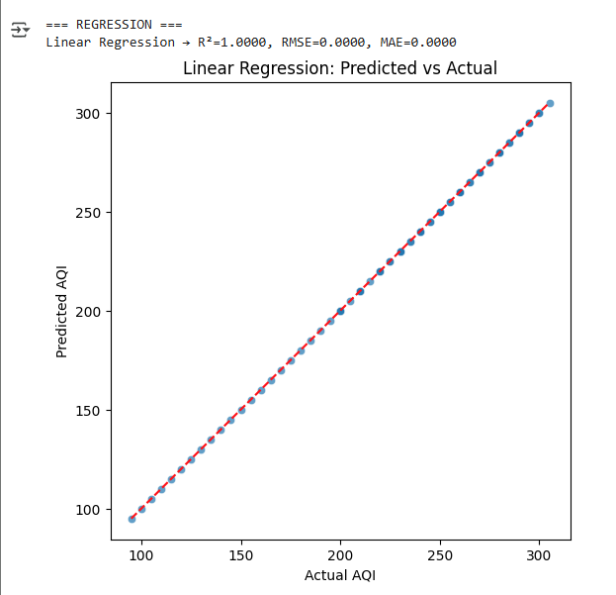
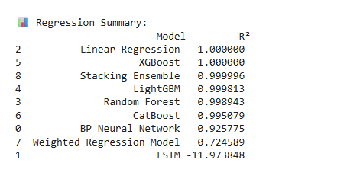
Visual Results
08
Visual Results

Slide 11
Conclusion
09
Conclusion
• Ensemble methods improved AQI prediction performance.
• LightGBM and XGBoost achieved highest accuracy.
• ARIMA enhanced time-series forecasting.
• Future Work: Integrate meteorological factors & real-time dashboards.

Slide 12
References
10
References
1. Liu, Q., Cui, B., & Liu, Z. (2024). Air Quality Class Prediction Using ML. Atmosphere, 15(5), 553.
2. Azid, A. et al. (2014). PCA & ANN for AQI Prediction.
3. Mishra, D. et al. (2019). ANN & MLR for PM2.5 Prediction.
4. Zhu, J. et al. (2021). ARIMA–BPNN Hybrid Model.
5. Du, S. et al. (2022). CNN–BiLSTM for AQI Forecasting.

Slide 13
Thank You

